Slide 1

Computational Geometry Project “Sweep Line Algorithm”
Under the guidance of:
Prof. Smita Kandekar
-Professor, Department of Mathematics, SPPU
Mr. Shubham Jagtap
-Alumni, Department of Mathematics, SPPU
Presented by:
Raji Utekar (23092029)
Archana Sonawane (23091049)
Avinash Desai (23091009)

Slide 2
Problem Statement:
Given n line segments (p1, q1), (p2, q2), . . . ,(pn, qn).
Find if the given line segments intersect with each other or not.
Input:
• First Line: Enter the number of line segments, n.
• Next n Lines: Each line contains the coordinates of the endpoints of a line segment, formatted as x1 y1 x2 y2, where (x1,y1) and (x2,y2) are the coordinates of the two endpoints of the line segment.
Output:
List all intersecting pairs of line segments. Each intersection should be reported as a pair of segment indices, with the index starting from 1.

Slide 3
Number of segments
Input:
5
5 5 10 3
8
(3, 7)
1 6 10 6
7
3 1 3 7
(9, 6)
3 4 5 5
(1, 6)
(10, 6)
(13, 6)
6
9 6 13 6
(5, 5)
5
4
(3, 4)
3
(10, 3)
2
1
(3, 1)
0
1
2
3
4
5
6
7
8
9
10
11
12
13
14
15

Slide 4
Input:
5
5 5 10 3
8
1 6 10 6
7
3 1 3 7
Seg ID: 2
Seg ID: 5
3 4 5 5
6
9 6 13 6
5
Seg ID: 4
Seg ID: 1
4
Output:
Line 2 3 intersects
Line 3 4 intersects
Line 4 1 intersects
Line 2 5 intersects
3
Seg ID: 3
2
1
0
1
2
3
4
5
6
7
8
9
10
11
12
13
14
15

Slide 5
Naive Approach
Loop through all pairs of segments:
For each pair of line segments i and j (where i < j), check if segment i intersects with segment j.

Slide 6
8
i = 1
7
Seg ID: 2
Seg ID: 5
6
5
Seg ID: 4
Seg ID: 1
4
3
Seg ID: 3
2
1
0
1
2
3
4
5
6
7
8
9
10
11
12
13
14
15

Slide 7
8
i = 1
j = 2
7
Seg ID: 2
Seg ID: 5
6
5
Seg ID: 4
Seg ID: 1
4
3
Seg ID: 3
Do intersect?
O
2
1
0
1
2
3
4
5
6
7
8
9
10
11
12
13
14
15

Slide 8
8
i = 1
j = 3
7
Seg ID: 2
Seg ID: 5
6
5
Seg ID: 4
Seg ID: 1
4
3
Seg ID: 3
Do intersect?
O
2
1
0
1
2
3
4
5
6
7
8
9
10
11
12
13
14
15

Slide 9
8
i = 1
j = 4
7
Seg ID: 2
Seg ID: 5
6
5
Seg ID: 4
Seg ID: 1
4
3
Seg ID: 3
Do intersect?
P
2
1
0
1
2
3
4
5
6
7
8
9
10
11
12
13
14
15

Slide 10
8
i = 1
j = 5
7
Seg ID: 2
Seg ID: 5
6
5
Seg ID: 4
Seg ID: 1
4
3
Seg ID: 3
Do intersect?
O
2
1
0
1
2
3
4
5
6
7
8
9
10
11
12
13
14
15

Slide 11
8
7
Seg ID: 2
Seg ID: 5
6
5
Seg ID: 4
Seg ID: 1
4
Output:
Line 1 4 intersects
3
Seg ID: 3
2
1
0
1
2
3
4
5
6
7
8
9
10
11
12
13
14
15

Slide 12
8
i = 2
7
Seg ID: 2
Seg ID: 5
6
5
Seg ID: 4
Seg ID: 1
4
3
Seg ID: 3
2
1
0
1
2
3
4
5
6
7
8
9
10
11
12
13
14
15

Slide 13
8
i = 2
j = 3
7
Seg ID: 2
Seg ID: 5
6
5
Seg ID: 4
Seg ID: 1
4
3
Seg ID: 3
Do intersect?
P
2
1
0
1
2
3
4
5
6
7
8
9
10
11
12
13
14
15

Slide 14
8
i = 2
j = 4
7
Seg ID: 2
Seg ID: 5
6
5
Seg ID: 4
Seg ID: 1
4
3
Seg ID: 3
Do intersect?
O
2
1
0
1
2
3
4
5
6
7
8
9
10
11
12
13
14
15

Slide 15
8
i = 2
j = 5
7
Seg ID: 2
Seg ID: 5
6
5
Seg ID: 4
Seg ID: 1
4
3
Seg ID: 3
Do intersect?
P
2
1
0
1
2
3
4
5
6
7
8
9
10
11
12
13
14
15

Slide 16
8
7
Seg ID: 2
Seg ID: 5
6
5
Seg ID: 4
Seg ID: 1
4
Output:
Line 1 4 intersects
Line 2 3 intersects
Line 2 5 intersects
3
Seg ID: 3
2
1
0
1
2
3
4
5
6
7
8
9
10
11
12
13
14
15

Slide 18
8
7
Seg ID: 2
Seg ID: 5
6
5
Seg ID: 4
Seg ID: 1
4
Output:
Line 2 3 intersects
Line 3 4 intersects
Line 4 1 intersects
Line 2 5 intersects
3
Seg ID: 3
2
1
0
1
2
3
4
5
6
7
8
9
10
11
12
13
14
15

Slide 19
Naive Approach
This will require $\left({n \atop 2}\right)$ comparisons, leading to the time complexity of $O(n^{2})$ .

Slide 20
Sweep Line Algorithm
class Point
{
int x;
int y;
}
Steps:
Define the following necessary classes:
Point : Having x and y coordinates.
Segment : Having start and end point with segment ID.
Event : Having information of all individual points.
class Segment
{
Point left, right;
int id;
}
class Event
{
int x, y;
bool isLeft;
int SegID;
}

Slide 21
int main()
{
//Initialize the variables
cout<<“Enter the number of segments”;
int n;
cin>>n;
vector<Segment> segments;
for(int i = 0 ; i < n; i++)
{
int x1, y1, x2, y2;
cout << "Enter segment " << i + 1 << " coordinates (x1 y1 x2 y2): ";
cin >> x1 >> y1 >> x2 >> y2;
segments.push_back(Segment(Point(x1, y1), Point(x2, y2), (i+1)));
}
return 0;
}
n = 5
Input:
5
5 5 10 3
n
segments
5 5 10 3 1
i = 0

Slide 22
int main()
{
//Initialize the variables
cout<<“Enter the number of segments”;
int n;
cin>>n;
vector<Segment> segments;
for(int i = 0 ; i < n; i++)
{
int x1, y1, x2, y2;
cout << "Enter segment " << i + 1 << " coordinates (x1 y1 x2 y2): ";
cin >> x1 >> y1 >> x2 >> y2;
segments.push_back(Segment(Point(x1, y1), Point(x2, y2), (i+1)));
}
return 0;
}
n = 5
Input:
5
5 5 10 3
segments
5 5 10 3 1
1 6 10 6 2
1 6 10 6
i = 1

Slide 23
int main()
{
//Initialize the variables
cout<<“Enter the number of segments”;
int n;
cin>>n;
vector<Segment> segments;
for(int i = 0 ; i < n; i++)
{
int x1, y1, x2, y2;
cout << "Enter segment " << i + 1 << " coordinates (x1 y1 x2 y2): ";
cin >> x1 >> y1 >> x2 >> y2;
segments.push_back(Segment(Point(x1, y1), Point(x2, y2), (i+1)));
}
return 0;
}
n = 5
Input:
5
5 5 10 3
segments
5 5 10 3 1
1 6 10 6 2
3 1 3 7 3
3 4 5 5 4
9 6 13 6 5
1 6 10 6
3 1 3 7
3 4 5 5
9 6 13 6

Slide 24
int main()
{
//Initialize the variables
cout<<“Enter the number of segments”;
int n;
cin>>n;
vector<Segment> segments;
for(int i = 0 ; i < n; i++)
{
int x1, y1, x2, y2;
cout << "Enter segment " << i + 1 << " coordinates (x1 y1 x2 y2): ";
cin >> x1 >> y1 >> x2 >> y2;
segments.push_back(Segment(Point(x1, y1), Point(x2, y2), (i+1)));
}
//Find and print intersecting segments
findIntersections(segments);
return 0;
}
n = 5
segments
5 5 10 3 1
1 6 10 6 2
3 1 3 7 3
3 4 5 5 4
9 6 13 6 5

Slide 25
void findIntersections(vector<segment> segments)
{
int n = segments.size(); //returns the size of Segments vector
//Creating events vector
vector<Event> events;
}
n = 5
vector<Event>
events

Slide 26
8
1
6
true
2
3
7
false
3
9
6
true
5
10
6
false
2
13
6
false
5
7
6
vector<Event>
5
5
5
false
4
5
5
true
1
events
5 5 true 1
10 3 false 1
1 6 true 2
10 6 false 2
3 1 true 3
3 7 false 3
3 4 true 4
5 5 false 4
9 6 true 5
13 6 false 5
3
4
true
4
4
3
10
3
false
1
2
3
1
true
3
1
0
1
2
3
4
5
6
7
8
9
10
11
12
13
14
15

Slide 27
void findIntersections(vector<segment> segments)
{
int n = segments.size(); //returns the size of Segments vector
//Creating events vector
vector<Event> events;
for (int i = 0; i < n; i++)
{
//setting segments' left point in events vector
events.push_back(Event(segments[i].left.x, segments[i].left.y, true, i));
//setting segments' right point in events vector
events.push_back(Event(segments[i].right.x, segments[i].right.y, false, i));
}
}

Slide 28
void findIntersections(vector<segment> segments)
{
int n = segments.size(); //returns the size of Segments vector
//Creating events vector
vector<Event> events;
for (int i = 0; i < n; i++)
{
//setting segments' left point in events vector
events.push_back(Event(segments[i].left.x, segments[i].left.y, true, i));
//setting segments' right point in events vector
events.push_back(Event(segments[i].right.x, segments[i].right.y, false, i));
}
//Sort the events
sort(events.begin(), events.end());
}

Slide 29
Sort the events to start the sweep line:
sort(events.begin(), events.end());
It is defined inside <algorithm> header file.
Syntax: sort(first, last, comp);
Return value: does not return any value.
class Event{
int x, y;
bool isLeft;
int segID;
bool operator<(const Event& other) const{
if(x == other.x) return y < other.y;
return x < other.x;
}

Slide 30
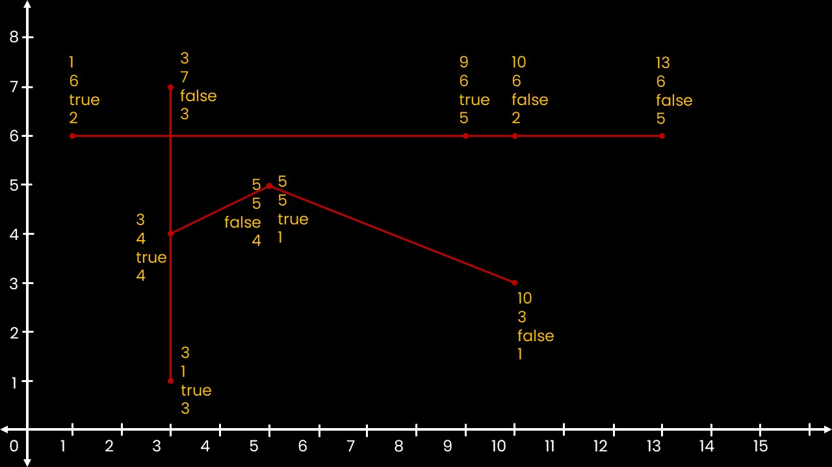
vector<Segment>
vector<Event>
segments
5 5 10 3 1
1 6 10 6 2
3 1 3 7 3
3 4 5 5 4
9 6 13 6 5
events
5 5 true 1
10 3 false 1
1 6 true 2
10 6 false 2
3 1 true 3
3 7 false 3
3 4 true 4
5 5 false 4
9 6 true 5
13 6 false 5

Slide 31
vector<Segment>
vector<Event>
segments
5 5 10 3 1
1 6 10 6 2
3 1 3 7 3
3 4 5 5 4
9 6 13 6 5
events
1 6 true 2
3 1 true 3
3 4 true 4
3 7 false 3
5 5 true 1
5 5 false 4
9 6 true 5
10 3 false 1
10 6 false 2
13 6 false 5

Slide 32
void findIntersections(vector<segment> segments)
{
int n = segments.size(); //returns the size of Segments vector
//Creating events vector
vector<Event> events;
for (int i = 0; i < n; i++)
{
//setting segments' left point in events vector
events.push_back(Event(segments[i].left.x, segments[i].left.y, true, i));
//setting segments' right point in events vector
events.push_back(Event(segments[i].right.x, segments[i].right.y, false, i));
}
//Sort the events
sort(events.begin(), events.end());
//Create empty vector `activeSegments`
vector<Event> activeSegments;
}

Slide 33
//Create empty vector `activeSegments`
vector<Event> activeSegments;
for(int i = 0; i < 2*n; i++)
{
}
}

Slide 34
vector<Segment>
vector<Event>
vector<Event>
segments
5 5 10 3 1
1 6 10 6 2
3 1 3 7 3
3 4 5 5 4
9 6 13 6 5
events
1 6 true 2
3 1 true 3
3 4 true 4
3 7 false 3
5 5 true 1
5 5 false 4
9 6 true 5
10 3 false 1
10 6 false 2
13 6 false 5
activeSegments
i = 0

Slide 35
vector<Segment>
vector<Event>
vector<Event>
segments
5 5 10 3 1
1 6 10 6 2
3 1 3 7 3
3 4 5 5 4
9 6 13 6 5
events
1 6 true 2
3 1 true 3
3 4 true 4
3 7 false 3
5 5 true 1
5 5 false 4
9 6 true 5
10 3 false 1
10 6 false 2
13 6 false 5
activeSegments
i = 0
curr_index = 2
if(events[0].isLeft)

Slide 36
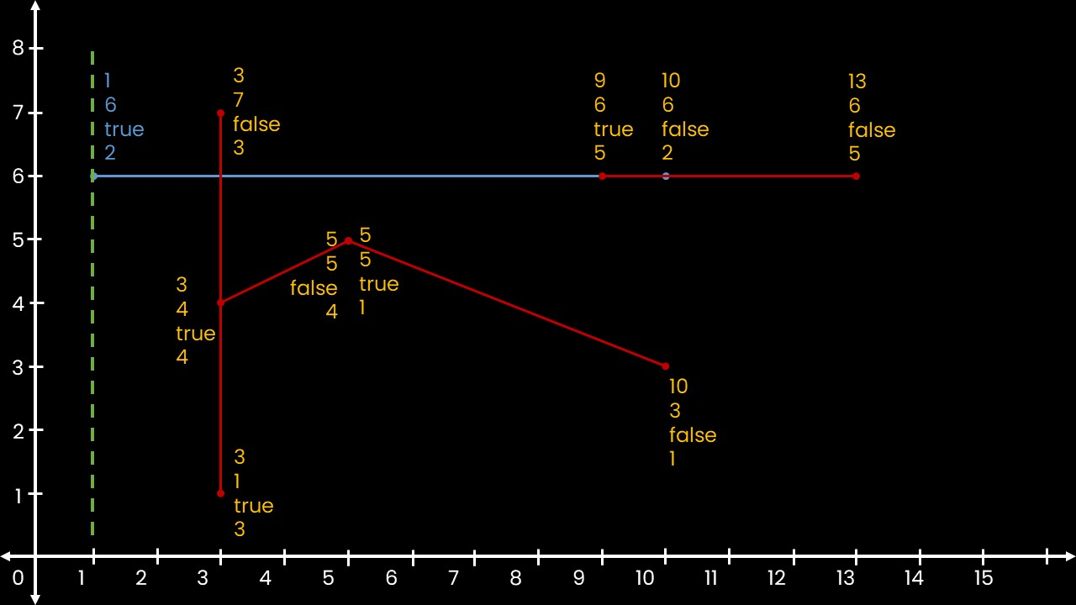
vector<Segment>
vector<Event>
vector<Event>
segments
5 5 10 3 1
1 6 10 6 2
3 1 3 7 3
3 4 5 5 4
9 6 13 6 5
events
1 6 true 2
3 1 true 3
3 4 true 4
3 7 false 3
5 5 true 1
5 5 false 4
9 6 true 5
10 3 false 1
10 6 false 2
13 6 false 5
activeSegments
1 6 true 2
i = 0
curr_index = 2
if(events[0].isLeft)

Slide 37
//Create empty vector `activeSegments`
vector<Event> activeSegments;
for(int i = 0; i < 2*n; i++)
{
int curr_index = events [i]. SegID ;
if ( events [i]. isLeft )
{
activeSegments . push_back ( events [i]);
}
}
}

Slide 38
vector<Segment>
vector<Event>
vector<Event>
segments
5 5 10 3 1
1 6 10 6 2
3 1 3 7 3
3 4 5 5 4
9 6 13 6 5
events
1 6 true 2
3 1 true 3
3 4 true 4
3 7 false 3
5 5 true 1
5 5 false 4
9 6 true 5
10 3 false 1
10 6 false 2
13 6 false 5
activeSegments
1 6 true 2
i = 1

Slide 39
vector<Segment>
vector<Event>
vector<Event>
segments
5 5 10 3 1
1 6 10 6 2
3 1 3 7 3
3 4 5 5 4
9 6 13 6 5
events
1 6 true 2
3 1 true 3
3 4 true 4
3 7 false 3
5 5 true 1
5 5 false 4
9 6 true 5
10 3 false 1
10 6 false 2
13 6 false 5
activeSegments
1 6 true 2
i = 1
curr_index = 3
if(events[1].isLeft)

Slide 40
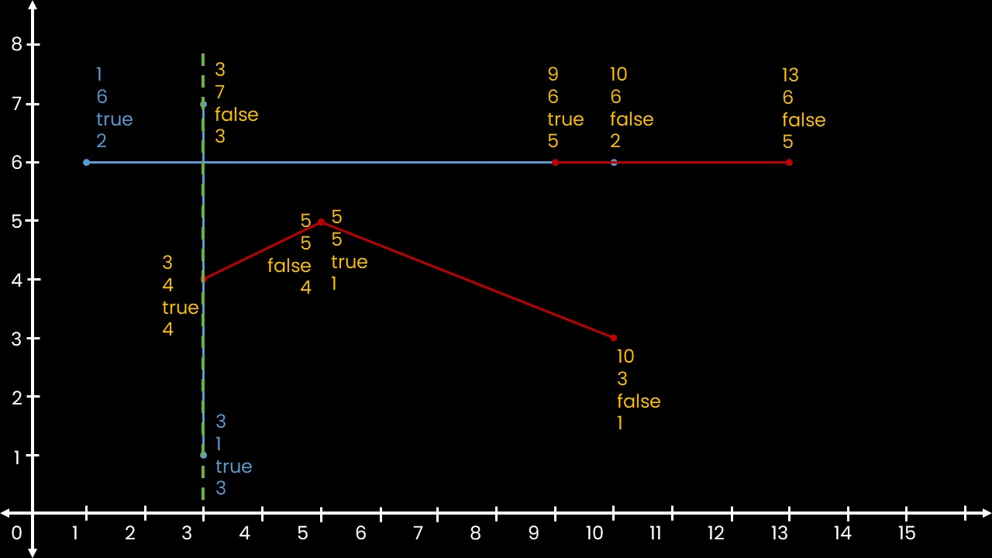
vector<Segment>
vector<Event>
vector<Event>
segments
5 5 10 3 1
1 6 10 6 2
3 1 3 7 3
3 4 5 5 4
9 6 13 6 5
events
1 6 true 2
3 1 true 3
3 4 true 4
3 7 false 3
5 5 true 1
5 5 false 4
9 6 true 5
10 3 false 1
10 6 false 2
13 6 false 5
activeSegments
1 6 true 2
3 1 true 3
i = 1
if(doIntersect(segments[3], segments[2]))
Output
Line 2 & 3 intersects
curr_index = 3
if(events[1].isLeft)

Slide 41
//Create empty vector `activeSegments`
vector<Event> activeSegments;
for(int i = 0; i < 2*n; i++)
{
int curr_index = events [i]. SegID ;
if ( events [i]. isLeft )
{
activeSegments . push_back ( events [i]);
if ( activeSegments . size () > 1)
{
for (auto it = activeSegments . rbegin () + 1; it != activeSegments . rend (); ++ it)
{
if ( doIntersect ( segments [ curr_index ], segments [it -> SegID ]))
cout << " Line " << (it -> SegID ) + 1 <<“ & " << curr_index + 1 << intersects " << endl;
}
}
}
}
}

Slide 42
vector<Segment>
vector<Event>
vector<Event>
segments
5 5 10 3 1
1 6 10 6 2
3 1 3 7 3
3 4 5 5 4
9 6 13 6 5
events
1 6 true 2
3 1 true 3
3 4 true 4
3 7 false 3
5 5 true 1
5 5 false 4
9 6 true 5
10 3 false 1
10 6 false 2
13 6 false 5
activeSegments
1 6 true 2
3 1 true 3
i = 2

Slide 43
vector<Segment>
vector<Event>
vector<Event>
segments
5 5 10 3 1
1 6 10 6 2
3 1 3 7 3
3 4 5 5 4
9 6 13 6 5
events
1 6 true 2
3 1 true 3
3 4 true 4
3 7 false 3
5 5 true 1
5 5 false 4
9 6 true 5
10 3 false 1
10 6 false 2
13 6 false 5
activeSegments
1 6 true 2
3 1 true 3
i = 2
curr_index = 4
if(events[2].isLeft)

Slide 44
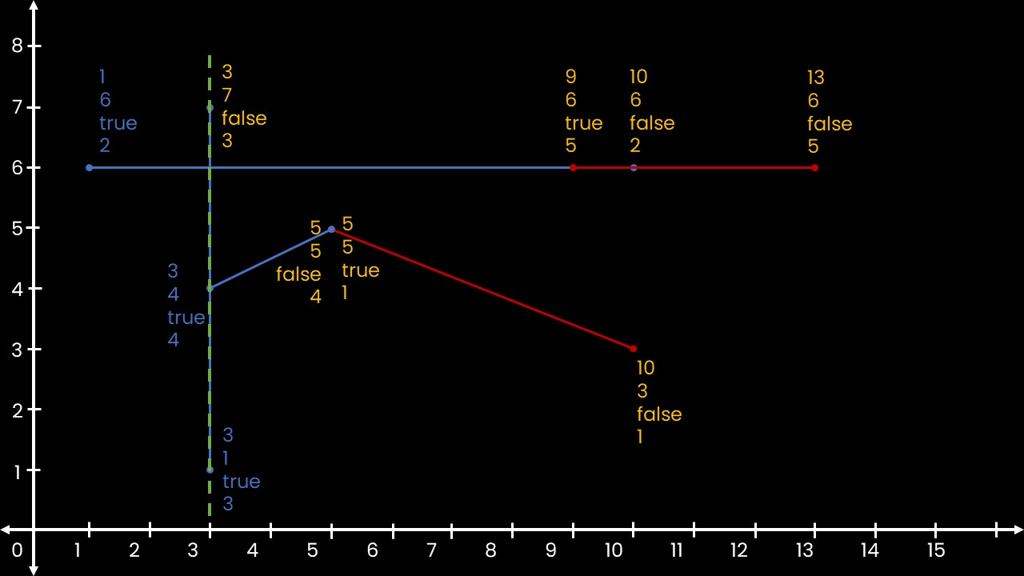
vector<Segment>
vector<Event>
vector<Event>
segments
5 5 10 3 1
1 6 10 6 2
3 1 3 7 3
3 4 5 5 4
9 6 13 6 5
events
1 6 true 2
3 1 true 3
3 4 true 4
3 7 false 3
5 5 true 1
5 5 false 4
9 6 true 5
10 3 false 1
10 6 false 2
13 6 false 5
activeSegments
1 6 true 2
3 1 true 3
3 4 true 4
i = 2
if(doIntersect(segments[4], segments[3]))
Output
Line 2 & 3 intersects
Line 4 & 3 intersects
curr_index = 4
if(doIntersect(segments[4], segments[2]))
if(events[2].isLeft)

Slide 45
vector<Segment>
vector<Event>
vector<Event>
segments
5 5 10 3 1
1 6 10 6 2
3 1 3 7 3
3 4 5 5 4
9 6 13 6 5
events
1 6 true 2
3 1 true 3
3 4 true 4
3 7 false 3
5 5 true 1
5 5 false 4
9 6 true 5
10 3 false 1
10 6 false 2
13 6 false 5
activeSegments
1 6 true 2
3 1 true 3
3 4 true 4
i = 3

Slide 46
vector<Segment>
vector<Event>
vector<Event>
segments
5 5 10 3 1
1 6 10 6 2
3 1 3 7 3
3 4 5 5 4
9 6 13 6 5
events
1 6 true 2
3 1 true 3
3 4 true 4
3 7 false 3
5 5 true 1
5 5 false 4
9 6 true 5
10 3 false 1
10 6 false 2
13 6 false 5
activeSegments
1 6 true 2
3 1 true 3
3 4 true 4
i = 3
curr_index = 3
else
if(events[3].isLeft)

Slide 47
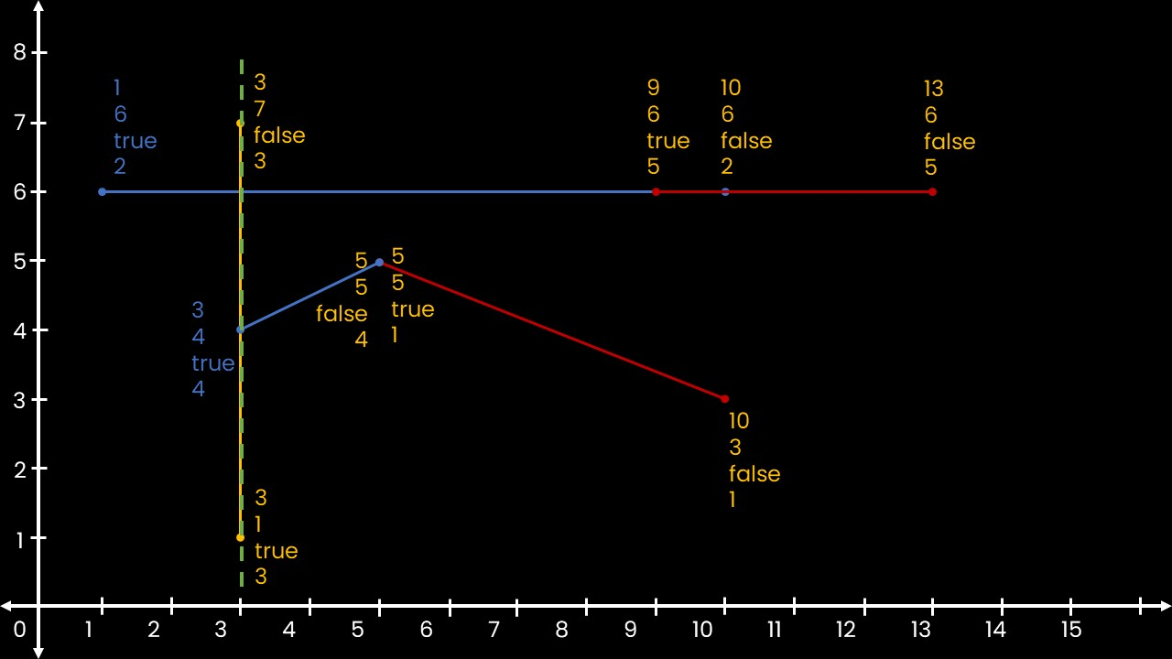
vector<Segment>
vector<Event>
vector<Event>
segments
5 5 10 3 1
1 6 10 6 2
3 1 3 7 3
3 4 5 5 4
9 6 13 6 5
events
1 6 true 2
3 1 true 3
3 4 true 4
3 7 false 3
5 5 true 1
5 5 false 4
9 6 true 5
10 3 false 1
10 6 false 2
13 6 false 5
activeSegments
1 6 true 2
3 4 true 4
i = 3
curr_index = 3
else

Slide 48
//Create empty vector `activeSegments`
vector<Event> activeSegments;
for(int i = 0; i < 2*n; i++)
{
int curr_index = events [i]. SegID ;
if ( events [i]. isLeft )
{
activeSegments . push_back ( events [i]);
if ( activeSegments . size () > 1)
{
for (auto it = activeSegments . rbegin () + 1; it != activeSegments . rend (); ++ it)
{
if ( doIntersect ( segments [ curr_index ], segments [it -> SegID ]))
cout << " Line " << (it -> SegID ) + 1 <<“ & " << curr_index + 1 << intersects " << endl;
}
}
}
else{
vector <Event > :: iterator iter ;
for ( iter = activeSegments . begin (); iter != activeSegments .end (); iter ++){
if (iter -> SegID == curr_index ){
activeSegments . erase ( iter );
break;
}
}
}
}
}

Slide 49
vector<Segment>
vector<Event>
vector<Event>
segments
5 5 10 3 1
1 6 10 6 2
3 1 3 7 3
3 4 5 5 4
9 6 13 6 5
events
1 6 true 2
3 1 true 3
3 4 true 4
3 7 false 3
5 5 true 1
5 5 false 4
9 6 true 5
10 3 false 1
10 6 false 2
13 6 false 5
activeSegments
1 6 true 2
3 4 true 4
i = 4

Slide 50
vector<Segment>
vector<Event>
vector<Event>
segments
5 5 10 3 1
1 6 10 6 2
3 1 3 7 3
3 4 5 5 4
9 6 13 6 5
events
1 6 true 2
3 1 true 3
3 4 true 4
3 7 false 3
5 5 true 1
5 5 false 4
9 6 true 5
10 3 false 1
10 6 false 2
13 6 false 5
activeSegments
1 6 true 2
3 4 true 4
i = 4
curr_index = 1
if(events[4].isLeft)

Slide 51
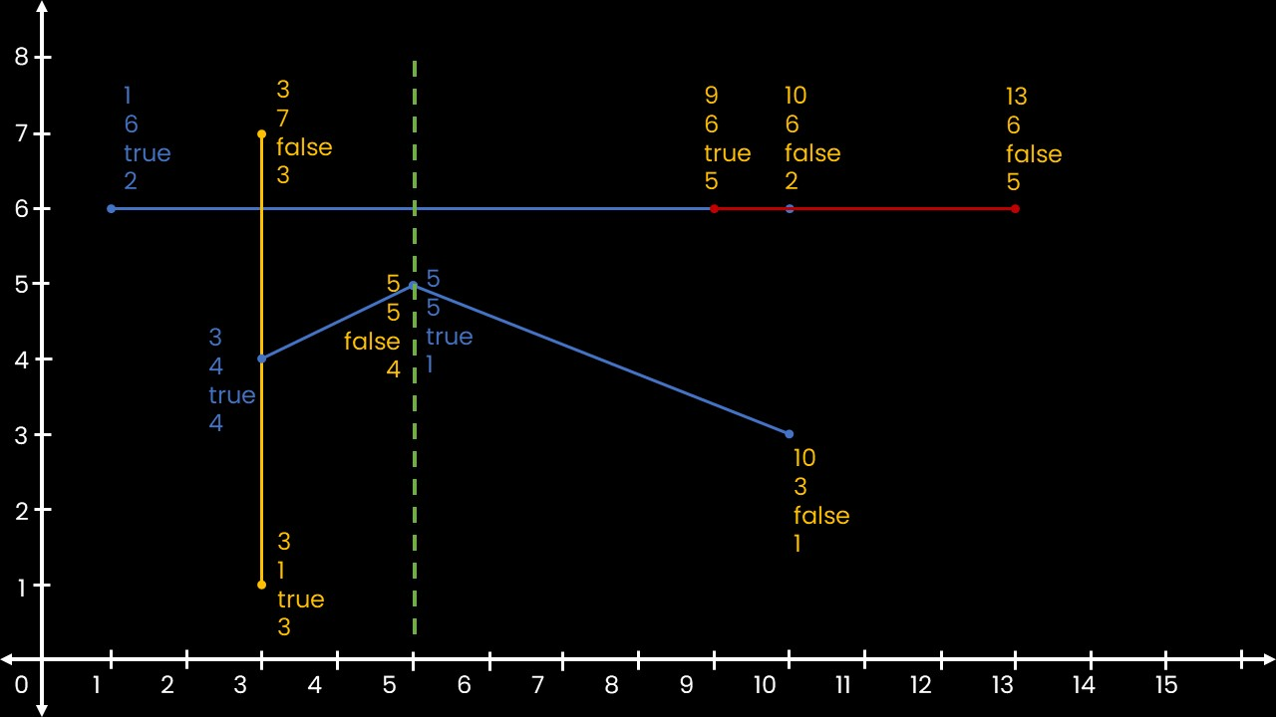
vector<Segment>
vector<Event>
vector<Event>
segments
5 5 10 3 1
1 6 10 6 2
3 1 3 7 3
3 4 5 5 4
9 6 13 6 5
events
1 6 true 2
3 1 true 3
3 4 true 4
3 7 false 3
5 5 true 1
5 5 false 4
9 6 true 5
10 3 false 1
10 6 false 2
13 6 false 5
activeSegments
1 6 true 2
3 4 true 4
5 5 true 1
i = 4
if(doIntersect(segments[1], segments[4]))
Output
Line 2 & 3 intersects
Line 4 & 3 intersects
Line 1 & 4 intersects
curr_index = 1
if(doIntersect(segments[1], segments[2]))
if(events[4].isLeft)

Slide 52
vector<Segment>
vector<Event>
vector<Event>
segments
5 5 10 3 1
1 6 10 6 2
3 1 3 7 3
3 4 5 5 4
9 6 13 6 5
events
1 6 true 2
3 1 true 3
3 4 true 4
3 7 false 3
5 5 true 1
5 5 false 4
9 6 true 5
10 3 false 1
10 6 false 2
13 6 false 5
activeSegments
1 6 true 2
3 4 true 4
5 5 true 1
i = 5

Slide 53
vector<Segment>
vector<Event>
vector<Event>
segments
5 5 10 3 1
1 6 10 6 2
3 1 3 7 3
3 4 5 5 4
9 6 13 6 5
events
1 6 true 2
3 1 true 3
3 4 true 4
3 7 false 3
5 5 true 1
5 5 false 4
9 6 true 5
10 3 false 1
10 6 false 2
13 6 false 5
activeSegments
1 6 true 2
3 4 true 4
5 5 true 1
i = 5
curr_index = 4
else
if(events[3].isLeft)

Slide 54
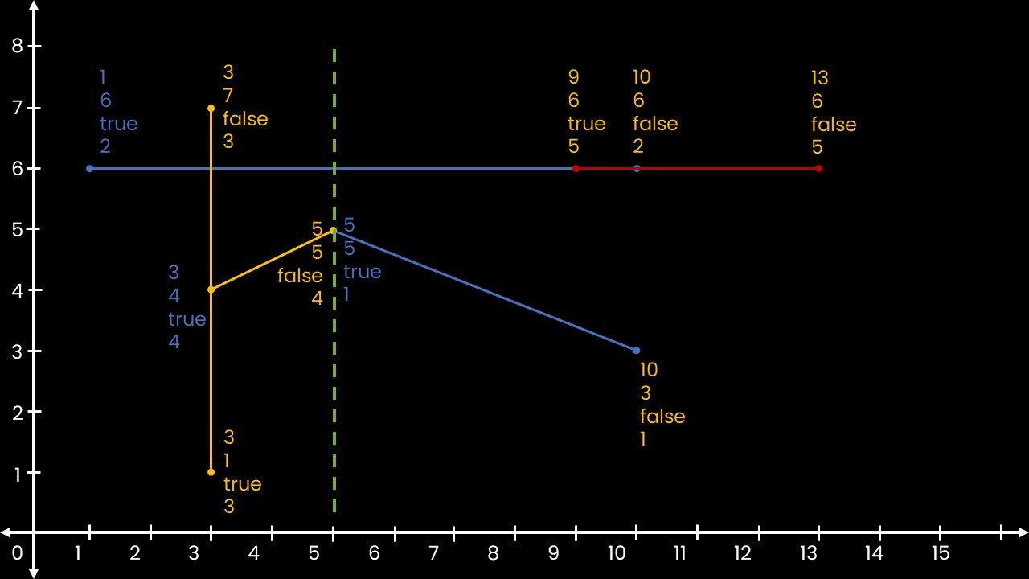
vector<Segment>
vector<Event>
vector<Event>
segments
5 5 10 3 1
1 6 10 6 2
3 1 3 7 3
3 4 5 5 4
9 6 13 6 5
events
1 6 true 2
3 1 true 3
3 4 true 4
3 7 false 3
5 5 true 1
5 5 false 4
9 6 true 5
10 3 false 1
10 6 false 2
13 6 false 5
activeSegments
1 6 true 2
5 5 true 1
i = 5
curr_index = 4
else

Slide 56
8
1
6
true
2
3
7
false
3
9
6
true
5
10
6
false
2
13
6
false
5
7
6
5
5
5
false
4
5
5
true
1
3
4
true
4
4
3
10
3
false
1
2
3
1
true
3
1
0
1
2
3
4
5
6
7
8
9
10
11
12
13
14
15

Slide 57
8
7
6
5
4
3
2
1
0
1
2
3
4
5
6
7
8
9
10
11
12
13
14
15

